Slide 1
Perfect Competition and Welfare
Copyright © 2019 Hal R. Varian

Slide 2
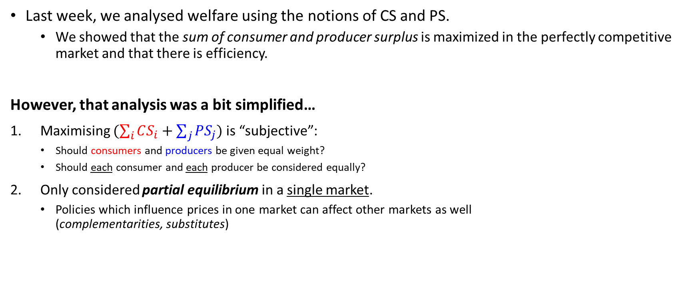
Recap
Last week, we analysed welfare using the notions of CS and PS.
We showed that the sum of consumer and producer surplus is maximized in the perfectly competitive market and that there is efficiency.
However, that analysis was a bit simplified…
Maximising $(\sum_{i}{CS_{i}}$ $+$ $\sum_{j}{PS_{j}})$ is “subjective”:
Should consumers and producers be given equal weight?
Should each consumer and each producer be considered equally?
Only considered partial equilibrium in a single market.
Policies which influence prices in one market can affect other markets as well (complementarities, substitutes)
Notes:
Recall that we said that choosing to maximise the sum of consumer and producer surplus involves certain assumptions?

Slide 3
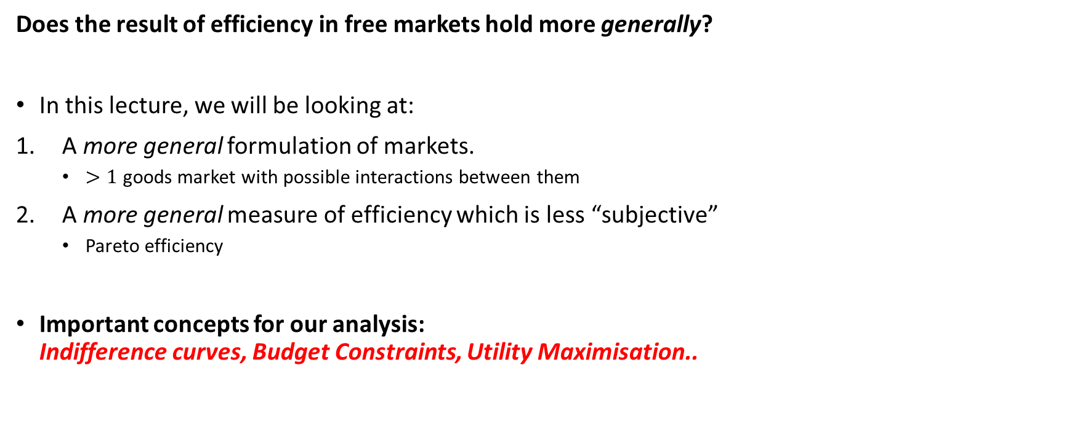
Introduction
Does the result of efficiency in free markets hold more generally?
In this lecture, we will be looking at:
A more general formulation of markets.
$>1$ goods market with possible interactions between them
A more general measure of efficiency which is less “subjective”
Pareto efficiency
Important concepts for our analysis: Indifference curves, Budget Constraints, Utility Maximisation..

Slide 4
A Simple Exchange Economy

Slide 5
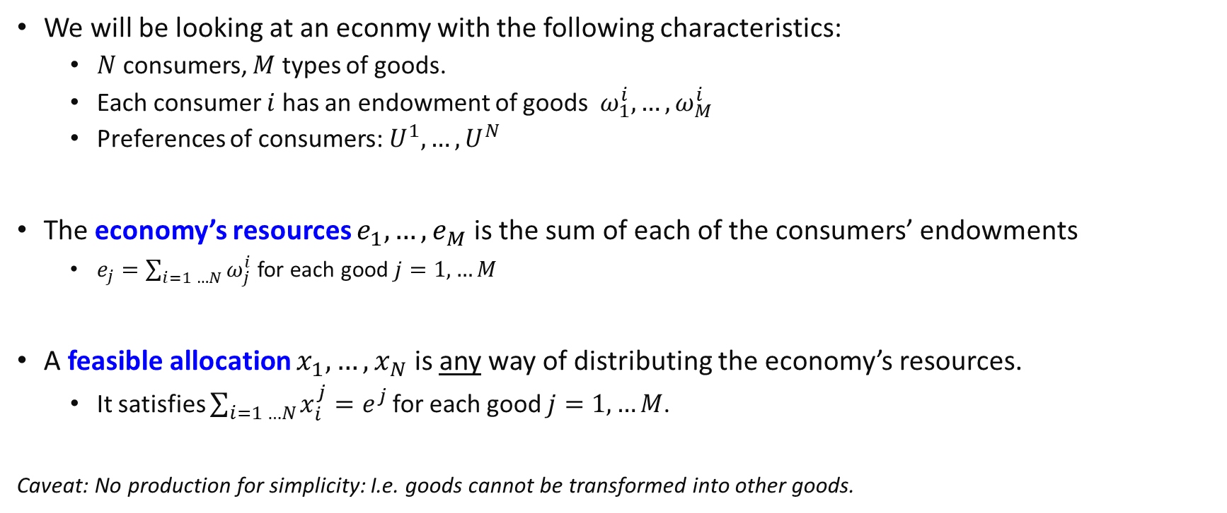
A Simple Exchange Economy
We will be looking at an econmy with the following characteristics:
$N$ consumers, $M$ types of goods.
Each consumer $i$ has an endowment of goods $ω_{1}^{i},…,ω_{M}^{i}$
Preferences of consumers:${ U}^{1},…, U^{N}$
The economy’s resources $e_{1},…,e_{M}$ is the sum of each of the consumers’ endowments
$e_{j}=\sum_{i=1 …N}{ω_{j}^{i}}$ for each good $j=1,…M$
A feasible allocation $x_{1}, …, x_{N}$ is any way of distributing the economy’s resources.
It satisfies $\sum_{i=1 …N}{x_{i}^{j}}=e^{j}$ for each good $j=1,…M$.
Caveat: No production for simplicity: I.e. goods cannot be transformed into other goods.

Slide 6
The Simple Exchange Economy
We will be examining the outcomes of such an economy when we allow for trade in markets.
What will be the resultant “equilibria”?
What are the characteristics of such equilibria?
A particular criterion we are interested in is pareto efficiency.
It captures efficiency in a more general manner compared to producer and consumer surplus

Slide 7
Pareto Efficiency

Slide 8
Pareto Efficiency
An economic situation is pareto efficient if there is no way to make any person better off without hurting anybody else.
Why? If it was possible to make someone better off without hurting anyone else, resources must have been used/distributed inefficiently!
For example, if durians are given to someone who dislikes durians -> this is not efficient as giving them instead to someone who likes durians will make everybody happier!
Notice that this abstracts from any idea of how much we should weigh each person’s utility.
We will be focusing on the pareto efficiency of allocations of goods for consumption.

Slide 9
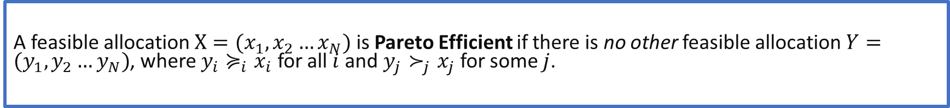
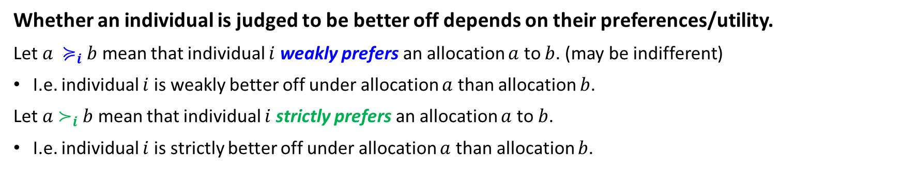
Pareto Efficiency
Whether an individual is judged to be better off depends on their preferences/utility.
Let $a{ ≽}_{i} b$ mean that individual $i$ weakly prefers an allocation $a$ to $b$. (may be indifferent)
I.e. individual $i$ is weakly better off under allocation $a$ than allocation $b$.
Let $a{ ≻}_{i} b$ mean that individual $i$ strictly prefers an allocation $a$ to $b$.
I.e. individual $i$ is strictly better off under allocation $a$ than allocation $b$.
A feasible allocation $X=(x_{1},x_{2}…x_{N})$ is Pareto Efficient if there is no other feasible allocation $Y=(y_{1},y_{2}…y_{N})$, where $y_{i}≽_{i}x_{i}$ for all $i$ and $y_{j}≻_{j}x_{j}$ for some $j$.

Slide 10
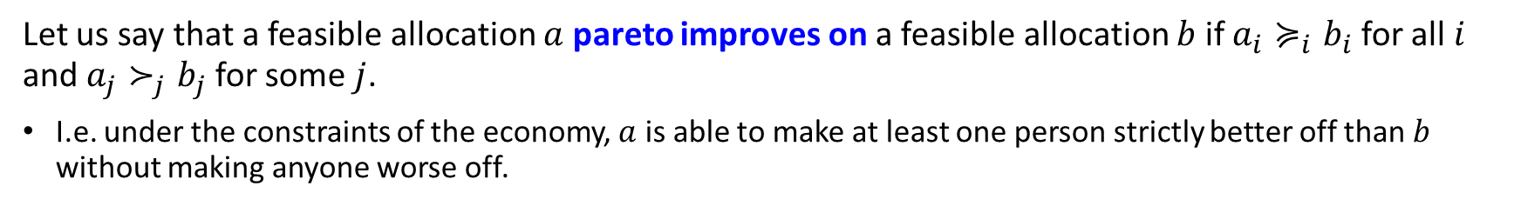
Pareto Efficiency
Let us say that a feasible allocation $a$ pareto improves on a feasible allocation $b$ if $a_{i}≽_{i}b_{i}$ for all $i$ and $a_{j}≻_{j}b_{j}$ for some $j$.
I.e. under the constraints of the economy, $a$ is able to make at least one person strictly better off than $b$ without making anyone worse off.
A feasible allocation $X=(x_{1},x_{2}…x_{N})$ is Pareto Efficient if there is no other feasible allocation $Y=(y_{1},y_{2}…y_{N})$, which pareto improves on it.
Note that if $a$ pareto improves on $b$, it does not mean that $a$ is pareto efficient!! For example, $c$ could in turn pareto improve on $a$.
Notes:
These definitions are equivalent.

Slide 11

Review Question 1
Consider the allocation of 10 apples and 10 oranges between person A and person B. Person A has utility = #apples. Person B has utility = #apples + # oranges. Select all options which are pareto efficient.
Person A: 10 oranges, Person B: 10 apples
Person A: 10 apples, Person B: 10 oranges
Person A: 5 apples, Person B: 5 apples and 10 oranges
Person A: 0 apples, Person B: 10 apples and 10 oranges
Hint: Try and find an allocation which pareto improves on each option. I.e. is it possible to make Person A or Person B strictly better off without hurting the other?

Slide 12
The Exchange Economy and Pareto Efficiency

Slide 13
The First Fundamental Welfare Theorem
FWT: “A competitive equilibrium is Pareto efficient.”
Given any combination of (not-too crazy) utility functions of consumers, and (not-too-crazy) cost functions of firms, the resulting competitive equilibrium in a free market is Pareto efficient.
We will examine this statement for the case of a two good - two consumer exchange economy.
Graphical illustration using indifference curves.., but for 2 consumers at the same time!

Slide 14
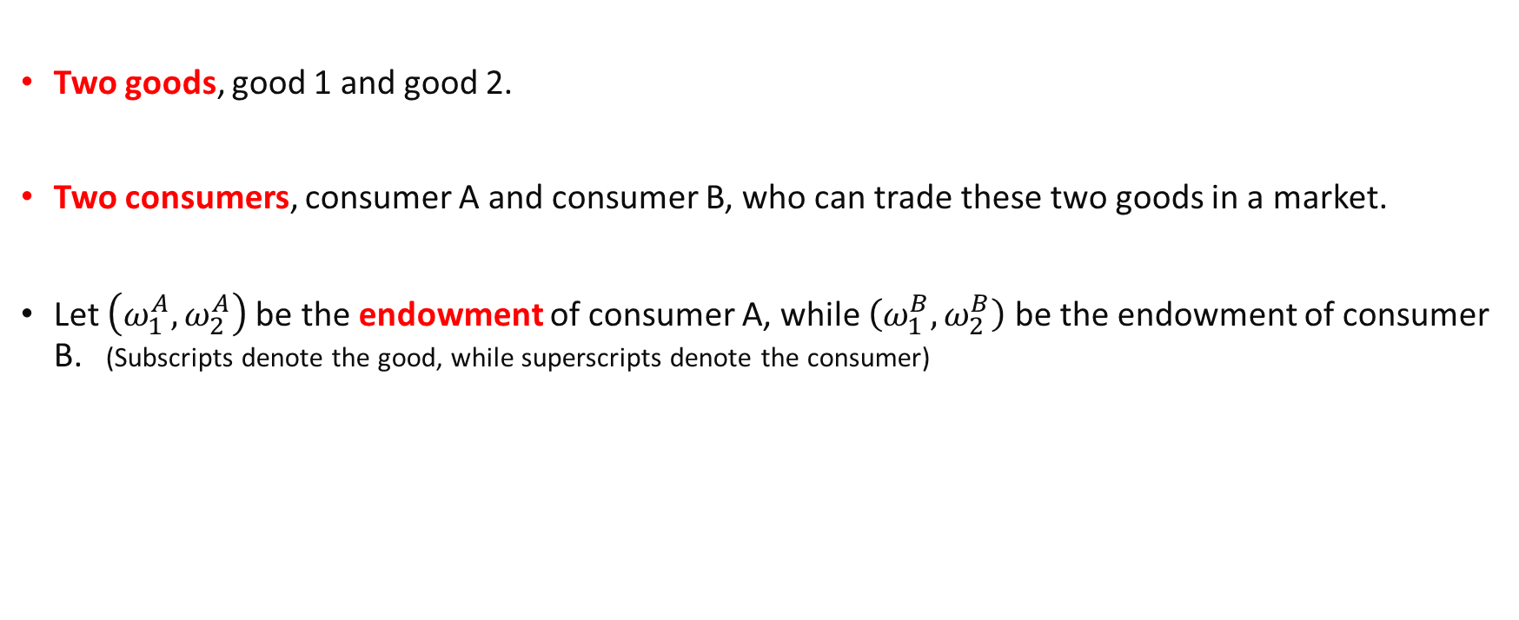
A two good, two consumer exchange economy
Two goods, good 1 and good 2.
Two consumers, consumer A and consumer B, who can trade these two goods in a market.
Let $\left(ω_{1}^{A},ω_{2}^{A}\right)$be the endowment of consumer A, while $\left(ω_{1}^{B},ω_{2}^{B}\right)$ be the endowment of consumer B. (Subscripts denote the good, while superscripts denote the consumer)

Slide 15
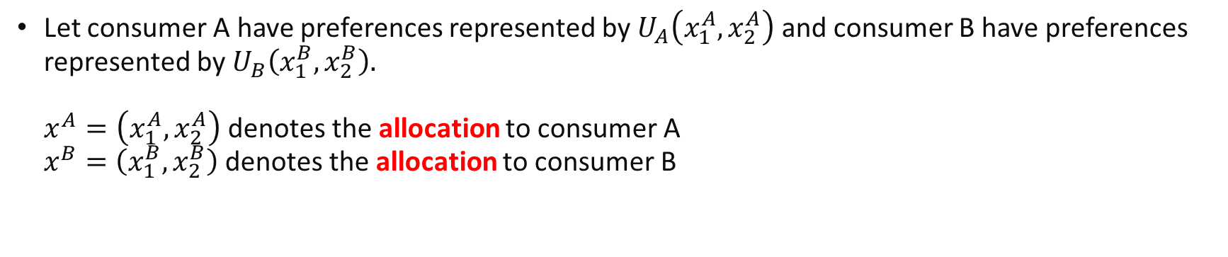
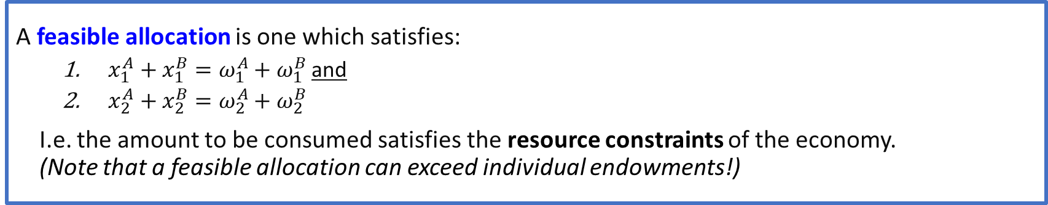
A two good, two consumer exchange economy
Let consumer A have preferences represented by $U_{A}\left(x_{1}^{A},x_{2}^{A}\right)$ and consumer B have preferences represented by $U_{B}\left(x_{1}^{B},x_{2}^{B}\right).$ $x^{A}=\left(x_{1}^{A},x_{2}^{A}\right)$denotes the allocation to consumer A $x^{B}=\left(x_{1}^{B},x_{2}^{B}\right)$denotes the allocation to consumer B
A feasible allocation is one which satisfies:
$x_{1}^{A}+x_{1}^{B}=ω_{1}^{A}+ω_{1}^{B}$ and
$x_{2}^{A}+x_{2}^{B}=ω_{2}^{A}+ω_{2}^{B}$
I.e. the amount to be consumed satisfies the resource constraints of the economy. (Note that a feasible allocation can exceed individual endowments!)

Slide 16
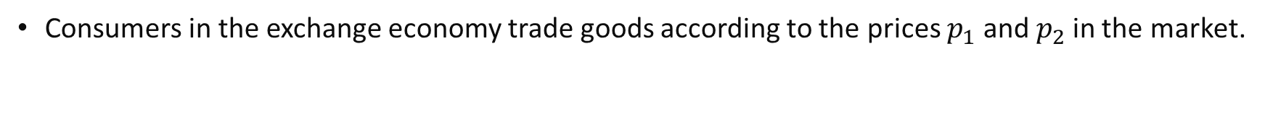
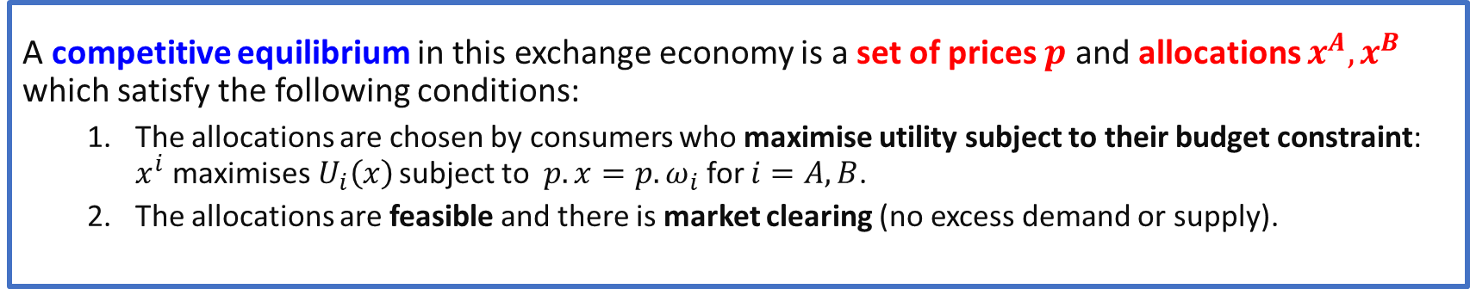
Equilibrium in the exchange economy
Consumers in the exchange economy trade goods according to the prices $p_{1}$ and $p_{2}$in the market.
A competitive equilibrium in this exchange economy is a set of prices $p$ and allocations $x^{A}, x^{B}$ which satisfy the following conditions:
The allocations are chosen by consumers who maximise utility subject to their budget constraint: $x^{i}$maximises$U_{i}\left(x\right)$ subject to $p.x={p.ω}_{i}$ for $i=A,B$.
The allocations are feasible and there is market clearing (no excess demand or supply).

Slide 17
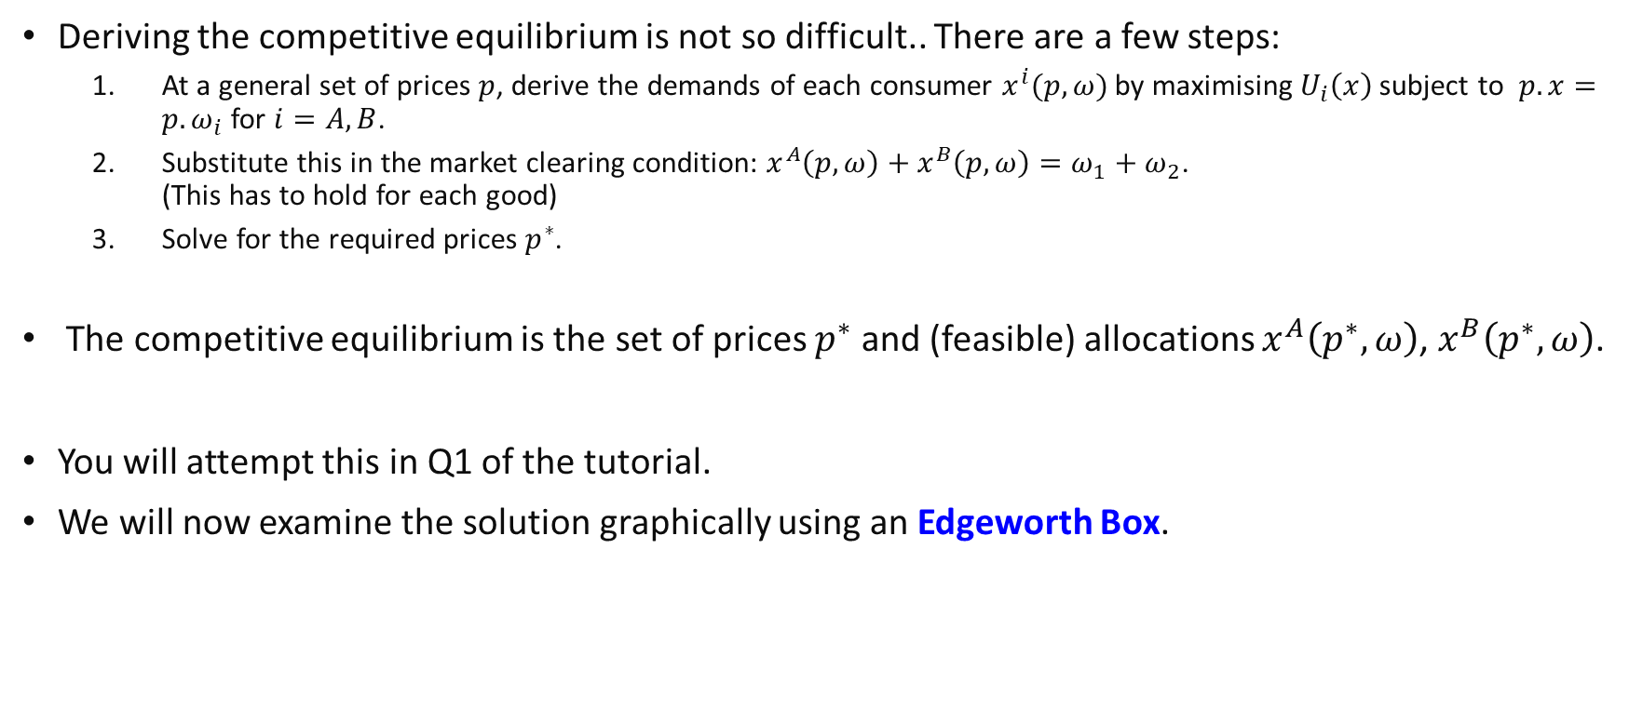
Equilibrium in the exchange economy
Deriving the competitive equilibrium is not so difficult.. There are a few steps:
At a general set of prices $p$, derive the demands of each consumer $x^{i}(p,ω)$ by maximising$U_{i}\left(x\right)$ subject to $p.x={p.ω}_{i}$ for $i=A,B$.
Substitute this in the market clearing condition: $x^{A}\left(p,ω\right)+x^{B}\left(p,ω\right)=ω_{1}+ω_{2}$. (This has to hold for each good)
Solve for the required prices $p^{∗}$.
The competitive equilibrium is the set of prices $p^{∗}$ and (feasible) allocations $x^{A}\left(p^{∗},ω\right)$, $x^{B}\left(p^{∗},ω\right)$.
You will attempt this in Q1 of the tutorial.
We will now examine the solution graphically using an Edgeworth Box.

Slide 18
The Edgeworth Box

Slide 19
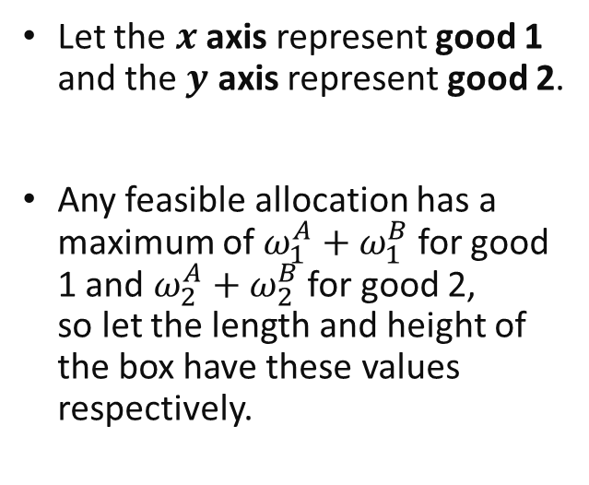

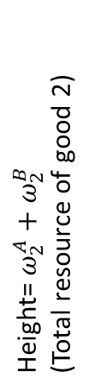
An Edgeworth Box
Length= $ω_{1}^{A}+ω_{1}^{B}$ (Total resource of good 1)
Let the $x$ axis represent good 1 and the $y$ axis represent good 2.
Any feasible allocation has a maximum of $ω_{1}^{A}+ω_{1}^{B}$ for good 1 and $ω_{2}^{A}+ω_{2}^{B}$ for good 2, so let the length and height of the box have these values respectively.
Height= $ω_{2}^{A}+ω_{2}^{B}$
(Total resource of good 2)

Slide 20


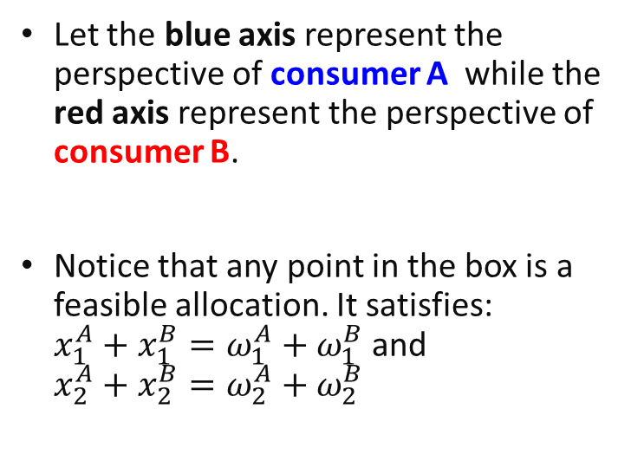






An Edgeworth Box
$$x_{2}^{A}$$
Length= $ω_{1}^{A}+ω_{1}^{B}$ (Total resource of good 1)
$$x_{1}^{B}$$
Let the blue axis represent the perspective of consumer A while the red axis represent the perspective of consumer B.
Notice that any point in the box is a feasible allocation. It satisfies: $x_{1}^{A}+x_{1}^{B}=ω_{1}^{A}+ω_{1}^{B}$ and $x_{2}^{A}+x_{2}^{B}=ω_{2}^{A}+ω_{2}^{B}$
$$x_{2}^{B}$$
Height= $ω_{2}^{A}+ω_{2}^{B}$
(Total resource of good 2)
$$x_{1}^{A}$$
$$x_{1}^{B}$$
$$x_{2}^{A}$$
$$x_{1}^{A}$$
$$x_{2}^{B}$$

Slide 21




An Edgeworth Box
$$x_{2}^{A}$$
$$ω_{1}^{B}$$
$$x_{1}^{B}$$
$$ω_{2}^{B}$$
The endowment of consumer A and B is one such point in the set, so let us indicate it in the box.
Endowment point
$$ω_{2}^{A}$$
$$x_{1}^{A}$$
$$ω_{1}^{A}$$
$$x_{2}^{B}$$

Slide 22

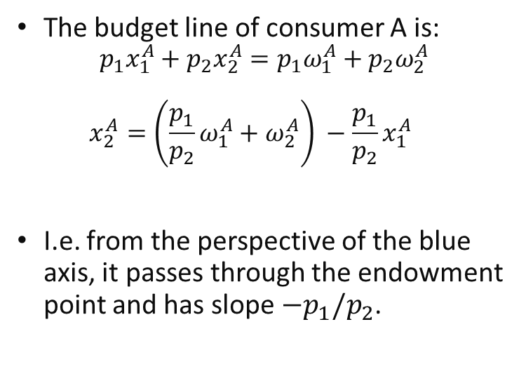
Adding the budget line to the box
$$x_{2}^{A}$$
$$x_{1}^{B}$$
The budget line of consumer A is: $p_{1}x_{1}^{A}+p_{2}x_{2}^{A}=p_{1}ω_{1}^{A}+p_{2}ω_{2}^{A}$ $x_{2}^{A}=\left({\frac{p_{1}}{p_{2}}ω}_{1}^{A}+ω_{2}^{A}\right) −\frac{p_{1}}{p_{2}}x_{1}^{A}$
I.e. from the perspective of the blue axis, it passes through the endowment point and has slope $−p_{1}/p_{2}$.
Endowment point
Budget line slope =$−\frac{p_{1}}{p_{2}}$
$$x_{1}^{A}$$
$$x_{2}^{B}$$
Notes:
The budget line always has to pass through the endowment as it is affordable.

Slide 23
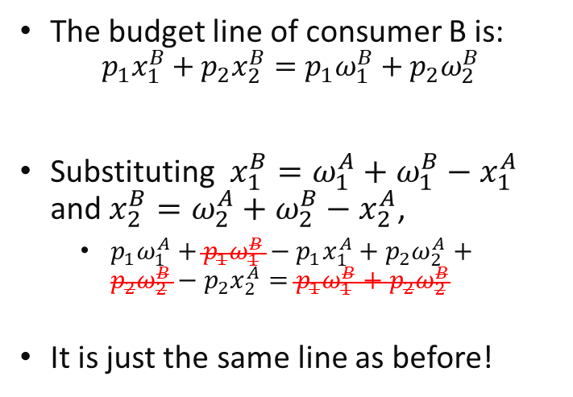
Adding the budget line to the box
$$x_{2}^{A}$$
The budget line of consumer B is: $p_{1}x_{1}^{B}+p_{2}x_{2}^{B}=p_{1}ω_{1}^{B}+p_{2}ω_{2}^{B}$
Substituting $x_{1}^{B}=ω_{1}^{A}+ω_{1}^{B}−x_{1}^{A}$ and $x_{2}^{B}=ω_{2}^{A}+ω_{2}^{B}−x_{2}^{A}$,
$p_{1}ω_{1}^{A}+{p_{1}ω}_{1}^{B}−{p_{1}x}_{1}^{A}+{p_{2}ω}_{2}^{A}+{p_{2}ω}_{2}^{B}−{p_{2}x}_{2}^{A}=p_{1}ω_{1}^{B}+p_{2}ω_{2}^{B}$
It is just the same line as before!
$$x_{1}^{B}$$
Endowment point
Budget line slope =$−\frac{p_{1}}{p_{2}}$
Set of affordable allocations of consumer A
$$x_{1}^{A}$$
Set of affordable allocations of consumer B
$$x_{2}^{B}$$
Notes:
In general, any line from the perspective of B is the same line from the perspective of A.
This is because of the relationship between each of their allocations. (They always sum to the endowment).
because $\frac{dX_{2}^{A}}{dX_{1}^{A}}=\frac{dX_{2}^{A}}{dX_{2}^{B}}×\frac{dX_{2}^{B}}{dX_{1}^{A}}=\frac{dX_{2}^{A}}{dX_{2}^{B}}×\frac{dX_{1}^{B}}{dX_{1}^{A}}×\frac{dX_{2}^{B}}{dX_{1}^{B}}=\left(−1\right)×\left(−1\right)×\frac{dX_{2}^{B}}{dX_{1}^{B}}=a$

Slide 24






Adding preferences to the Box..
To answer questions like:
Which allocations will be blocked by one or both consumers?
Which allocations make both consumers better off?
What will be the competitive market allocation?
We need to add preferences to the box… (Indifference curves)
$$x_{2}^{A}$$
$$x_{2}^{B}$$
Increasing utility
Increasing utility
$$x_{2}^{B}$$
Increasing utility
$$x_{1}^{A}$$
$$x_{1}^{B}$$
Consumer A
Consumer B
$$x_{1}^{B}$$
Notes:
Notice that everything for consumer B is just being rotated 180 degrees.
Rotating any lines from the perspective of consumer B 180 degrees, will give us a line with the same slope.
Hence, we can just focus on the slope of lines from the perspective of the blue axis.

Slide 25
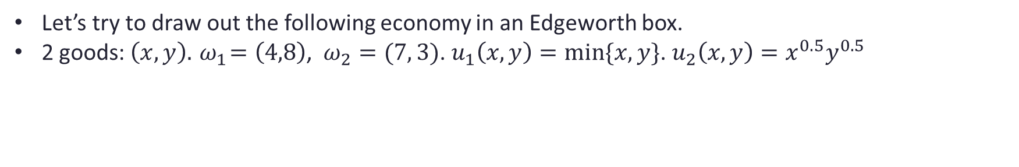
Example
Let’s try to draw out the following economy in an Edgeworth box.
2 goods: $\left(x,y\right).{ ω}_{1}=\left(4,8\right)$, $ω_{2}=(7, 3)$. $u_{1}\left(x,y\right)=min⁡\{x,y\}$. $u_{2}\left(x,y\right)=x^{0.5}y^{0.5}$

Slide 26
Pareto efficiency in the Edgeworth Box

Slide 27

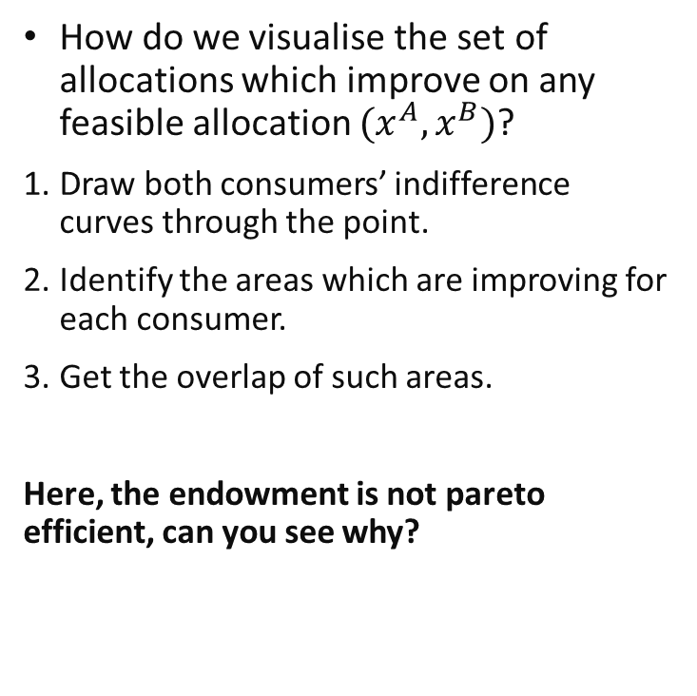
The set of pareto improving allocations
$$x_{2}^{A}$$
How do we visualise the set of allocations which improve on any feasible allocation $(x^{A},x^{B})$?
Draw both consumers’ indifference curves through the point.
Identify the areas which are improving for each consumer.
Get the overlap of such areas.
Here, the endowment is not pareto efficient, can you see why?
$$x_{1}^{B}$$
$$ω$$
Set of pareto improving allocations
$$x_{1}^{A}$$
$$x_{2}^{B}$$
Notes:
They can trade goods with each other to become both better off!

Slide 28
Pareto efficient allocations
$$x_{2}^{A}$$
A feasible allocation where the indifference curves are tangent to each other is pareto efficient.
Why? There is no other feasible allocation which can make one consumer better off without hurting the other… I.e. there are no pareto improvements!
$$x_{1}^{B}$$
Increasing utility for A
Increasing utility for B
$$x_{1}^{A}$$
$$x_{2}^{B}$$

Slide 29
The Contract Curve / Pareto Set
The contract curve shows all feasible allocations which are pareto efficient. It is also known as the pareto set.
At any point on the contract curve, indifference curves of consumers A and B are tangent to each other.
The contract curve is independent of endowments. Its shape generally depends on the structure of preferences.
$$x_{2}^{A}$$
$$x_{1}^{B}$$
Contract curve
$$x_{1}^{A}$$
$$x_{2}^{B}$$
Notes:
Note that if the MRS of consumer B is equals to a, i.e. the line of tangency to the indifferent curve has a slope $\frac{dX_{2}^{B}}{dX_{1}^{B}}=a$.
Then from the perspective of consumer A, the line also has slope $\frac{dX_{2}^{A}}{dX_{1}^{A}}=a$ from our earlier discussion.

Slide 30
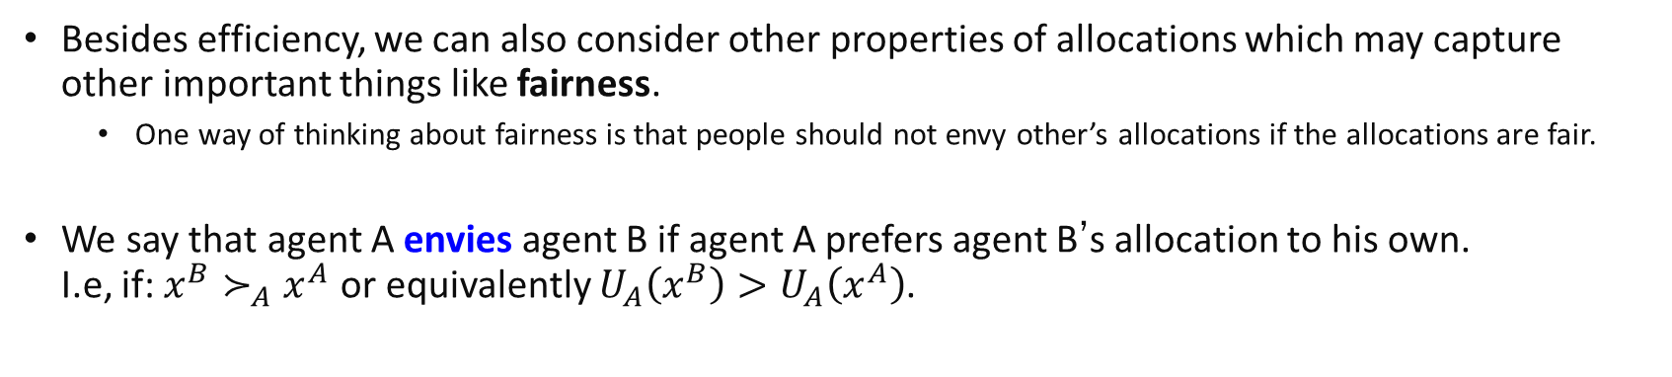
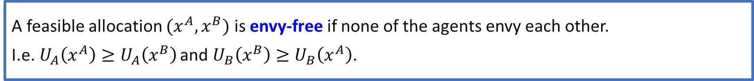
Fairness
Besides efficiency, we can also consider other properties of allocations which may capture other important things like fairness.
One way of thinking about fairness is that people should not envy other’s allocations if the allocations are fair.
We say that agent A envies agent B if agent A prefers agent B’s allocation to his own. I.e, if: $x^{B}≻_{A}x^{A}$ or equivalently $U_{A}\left(x^{B}\right)>U_{A}\left(x^{A}\right)$.
A feasible allocation $(x^{A},x^{B})$ is envy-free if none of the agents envy each other.
I.e.$U_{A}\left(x^{A}\right)≥U_{A}\left(x^{B}\right)$ and $U_{B}\left(x^{B}\right)≥U_{B}\left(x^{A}\right)$.

Slide 31




Fairness
A feasible allocation is said to be fair if it is 1) Pareto efficient AND 2) Envy free.
Fair allocations are a subset of the contract curve or pareto set.
$$x$$
A
$$y$$
$$y$$
A is an example of an envy free allocation. (But it is not pareto efficient)
$$x$$

Slide 32
Competitive Equilibrium in the Edgeworth Box

Slide 33

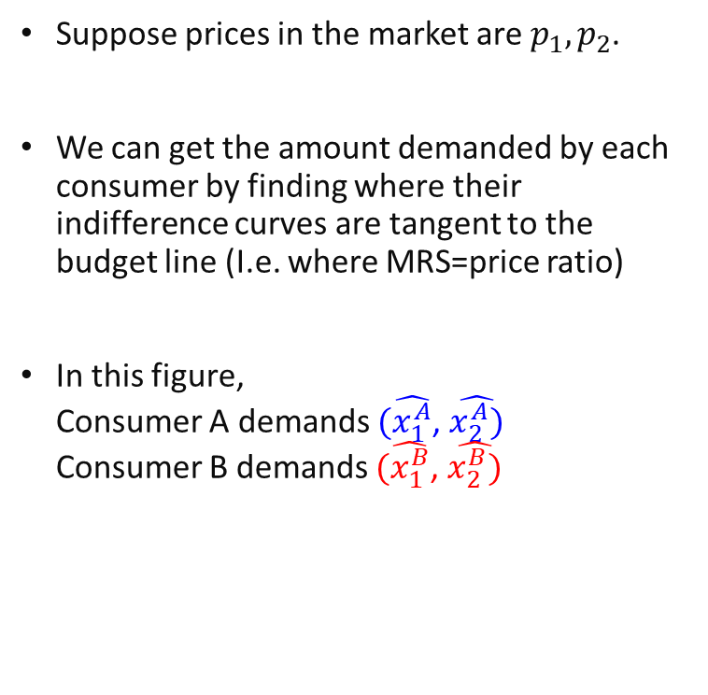




Utility Maximisation of Consumers
$$x_{2}^{A}$$
$$\hat{x_{1}^{B}}$$
Suppose prices in the market are $p_{1}, p_{2}$.
We can get the amount demanded by each consumer by finding where their indifference curves are tangent to the budget line (I.e. where MRS=price ratio)
In this figure, Consumer A demands $(\hat{x_{1}^{A}}$, $\hat{x_{2}^{A})}$ Consumer B demands $(\hat{x_{1}^{B}}$, $\hat{x_{2}^{B})}$
$$x_{1}^{B}$$
$$\hat{x_{2}^{A}}$$
$$ω$$
slope =$−\frac{p_{1}}{p_{2}}$
$$\hat{x_{2}^{B}}$$
$$x_{1}^{A}$$
$$\hat{x_{1}^{A}}$$
$$x_{2}^{B}$$

Slide 34

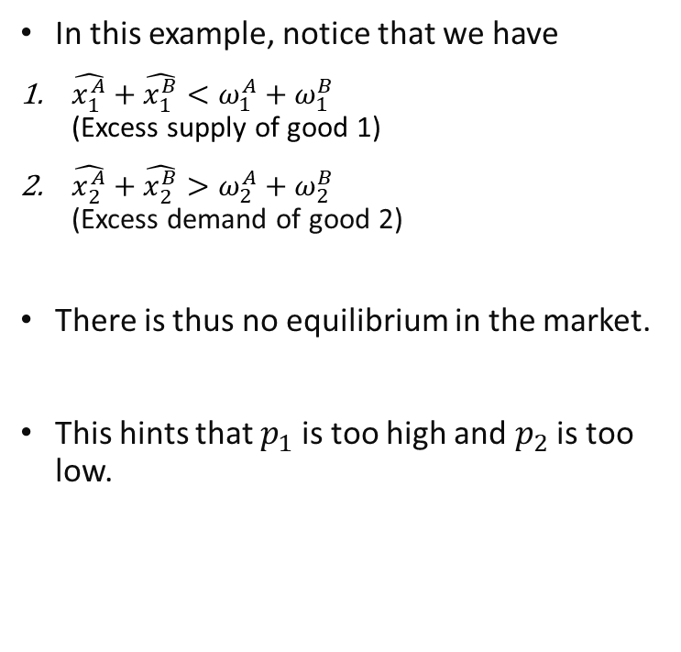


Disequilibrium in the Market
$$x_{2}^{A}$$
In this example, notice that we have
$\hat{x_{1}^{A}}+\hat{x_{1}^{B}}<ω_{1}^{A}+ω_{1}^{B}$ (Excess supply of good 1)
$\hat{x_{2}^{A}}+\hat{x_{2}^{B}}>ω_{2}^{A}+ω_{2}^{B}$ (Excess demand of good 2)
There is thus no equilibrium in the market.
This hints that $p_{1}$ is too high and $p_{2}$ is too low.
$$\hat{x_{1}^{B}}$$
$$x_{1}^{B}$$
$$\hat{x_{2}^{A}}$$
$$ω$$
slope =$−\frac{p_{1}}{p_{2}}$
$$\hat{x_{2}^{B}}$$
$$x_{1}^{A}$$
$$\hat{x_{1}^{A}}$$
$$x_{2}^{B}$$

Slide 35







Equilibrium in the Market
$$x_{2}^{A}$$
Prices of good 1 will decrease and/or prices of good 2 will increase until there is no excess supply or demand in the market.
In this figure, given the new prices $p_{1}^{∗},p_{2}^{∗}$, Consumer A demands $({x_{1}^{A}}^{∗}$, ${x_{2}^{A}}^{∗})$ Consumer B demands $({x_{1}^{B}}^{∗}$, ${x_{2}^{B}}^{∗})$
There is no excess demand or supply of each good.
Hence there is equilibrium in the market.
$$x_{1}^{B∗}$$
$$x_{1}^{B}$$
$$ω$$
New slope =$−\frac{p_{1}^{∗}}{p_{2}^{∗}}$
$${x_{2}^{A}}^{∗}$$
$$x_{2}^{B∗}$$
$$x_{1}^{A}$$
$${x_{1}^{A}}^{∗}$$
$$x_{2}^{B}$$
Notes:
Remember the slope is $−p_{1}/p_{2}$, so a fall in $p_{1}$ or rise in $p_{2}$ will lead cause the slope to become less steep.

Slide 36

Equilibrium in the Market
$$x_{2}^{A}$$
The equilibrium in the market is:
The price ratio $p_{1}^{∗}/p_{2}^{∗}$
The feasible allocation: $({x_{1}^{A}}^{∗}$, ${x_{2}^{A}}^{∗}), ({x_{1}^{B}}^{∗}$, ${x_{2}^{B}}^{∗})$ where consumers are utility maximising s.t. prices and endowment.
Note that it is the price ratio which is unique, not the prices themselves!
If the slope of the black line is $−m$, there are many sets of prices which give this value.
Usually, the price of one good is the numeraire and set to 1.
$$x_{1}^{B∗}$$
$$x_{1}^{B}$$
$$ω$$
New slope =$−\frac{p_{1}^{∗}}{p_{2}^{∗}}$
$${x_{2}^{A}}^{∗}$$
$$x_{2}^{B∗}$$
$$x_{1}^{A}$$
$${x_{1}^{A}}^{∗}$$
$$x_{2}^{B}$$
Notes:
Only the price ratio is unique in equilibrium.

Slide 37
Competitive equilibrium in Exchange
What else can we note from the figure?
By utility maximization, the price line must be tangent to both indifference curves of consumers A and B.
By market clearing, the two indifference curves are tangent at the same point. They are hence also tangent to each other!
As discussed earlier, this implies that the allocation is pareto efficient!
Hence, we have thus demonstrated the FWT: a competitive equilibrium is pareto efficient!
Notes:
Note that the FWT does not say that a competitive equilibrium will be fair, as there exist pareto efficient allocations which are not envy free and thus not fair.

Slide 38
Existence of equilibrium
In the previous figure, we illustrated a specific example of an equilibrium given endowments.
Perhaps you might worry that
This kind of equilibrium might not exist in certain cases..
There might be more than 1 equilibrium price and quantities?
It can be shown that for “standard” kinds of preferences, starting from any endowment, the market equilibrium exists and is unique.

Slide 39
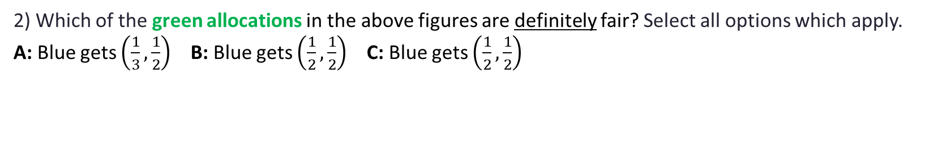



Review Questions 2
Suppose there is a total of 1 unit of good A and 1 unit of good B.
1) Which of the following Edgeworth Boxes illustrates a set of prices which are part of a competitive equilibrium? Select all options which apply.
$$ω$$
$$ω$$
$$ω$$
A
B
C
2) Which of the green allocations in the above figures are definitely fair? Select all options which apply.
A: Blue gets $\left(\frac{1}{3},\frac{1}{2}\right)$ B: Blue gets $\left(\frac{1}{2},\frac{1}{2}\right)$ C: Blue gets $\left(\frac{1}{2},\frac{1}{2}\right)$

Slide 40
The Second Fundamental Welfare Theorem

Slide 41
The Second Fundamental Welfare Theorem
Remember that from the contract curve, there can be infinitely many pareto efficient allocations in the Edgeworth box.
Some of them can be very unfair... (Remember Review question 1?)
Perhaps there is a pareto efficient allocation which society particularly prefers.. How can this pareto efficient allocation be attained?
The second welfare theorem addresses this by questioning whether there exists a redistribution of endowments which can lead to the pareto efficient allocation with trade in the market..

Slide 42
The Second Fundamental Welfare Theorem
SWT: “For any pareto efficient allocation, a social planner can come up with an initial transfer scheme such that a competitive equilibrium yields precisely the pareto efficient allocation.”
The answer is yes! This holds generally given any combination of (not-too crazy) utility functions of consumers, and (not-too-crazy) cost functions of firms.
Notes:
Note that as any fair allocation is also pareto efficient, the SWT will also hold for fair allocations.

Slide 43
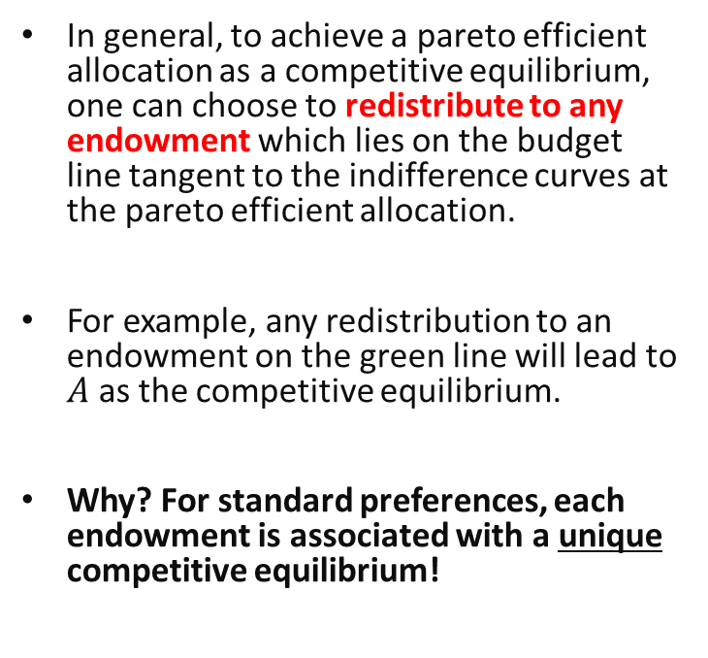
Illustration of the SWT
$$x_{2}^{A}$$
In general, to achieve a pareto efficient allocation as a competitive equilibrium, one can choose to redistribute to any endowment which lies on the budget line tangent to the indifference curves at the pareto efficient allocation.
For example, any redistribution to an endowment on the green line will lead to $A$ as the competitive equilibrium.
Why? For standard preferences, each endowment is associated with a unique competitive equilibrium!
$$x_{1}^{B}$$
A
$$x_{1}^{A}$$
$$x_{2}^{B}$$
Notes:
Can work backwards: since A is pareto efficient, there is a price line which is tangent to both of them.
We know that starting at any point on the price line, A is the competitive equilibrium.
For standard preferences it is also unique. Hence this guarantees that we will reach A.

Slide 44

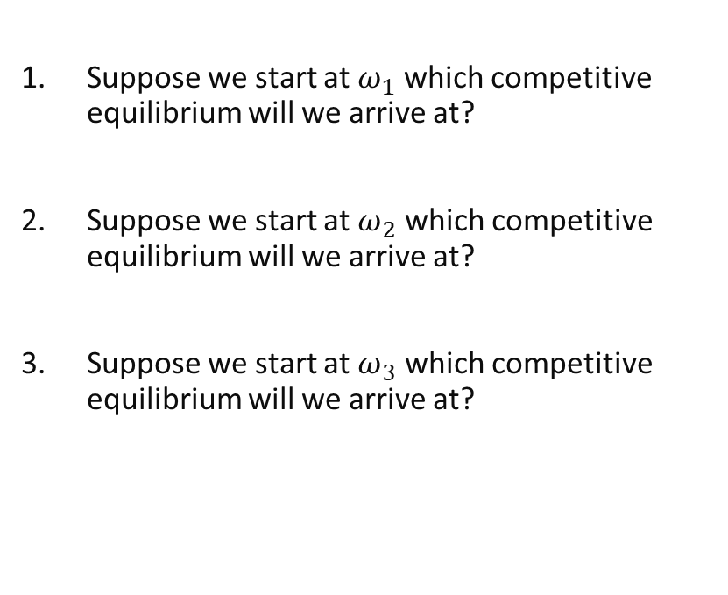


Review Questions 3
$$x_{2}^{A}$$
$$x_{1}^{B}$$
Suppose we start at $ω_{1}$ which competitive equilibrium will we arrive at?
Suppose we start at $ω_{2}$ which competitive equilibrium will we arrive at?
Suppose we start at $ω_{3}$ which competitive equilibrium will we arrive at?
$$ω_{1}$$
A=$ω_{3}$
B
C
$$ω_{2}$$
$$x_{1}^{A}$$
$$x_{2}^{B}$$

Slide 45
Implicit assumptions
Note that there are some implicit assumptions within this model:
Can trade any goods for money: Complete markets.
Utility only depends on own consumption: No externalities.
In HE3001, you will see that the external effects of one’s consumption can be treated as another good. If there is no trade in these externalities, then no complete markets..
Without these, the welfare theorems do not hold in general.

Slide 46
Key Learning Outcomes
What are the various parameters of a simple exchange economy?
What does it mean for an allocation to be pareto efficient, fair, or a competitive equilibrium?
How to perform analysis in an Edgeworth box for a two-person, two good exchange economy.
How to mathematically calculate the competitive equilibrium?
Implications of the First and Second Fundamental Welfare theorems.

Slide 47
Announcement
Quiz 5 will be released today. It will cover this week and last week’s lectures.

Slide 48

Readings
Varian Chapter 32
Varian, Chapter 34, last part
Varian Chapter 16 (optional) $−$ more background info.

